Slide 1
Introduction to Containers Cloud Kubernetes
Whitney High Hackathon
Steven Wong
Engineer, VMware
February 2019

Slide 2
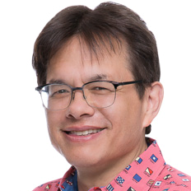
Speaker
Steve Wong Open Source Engineer VMware Cloud Native Applications Business Unit
Community participant:
Kubernetes

Slide 3
Recap: What is a container?
The world is changing
Why are people using container orchestrators and clouds
The Kubernetes project
Workshop – you use Kubernetes yourself to deploy a full n-tier application, running in the cloud, serving users on the internet

Slide 4
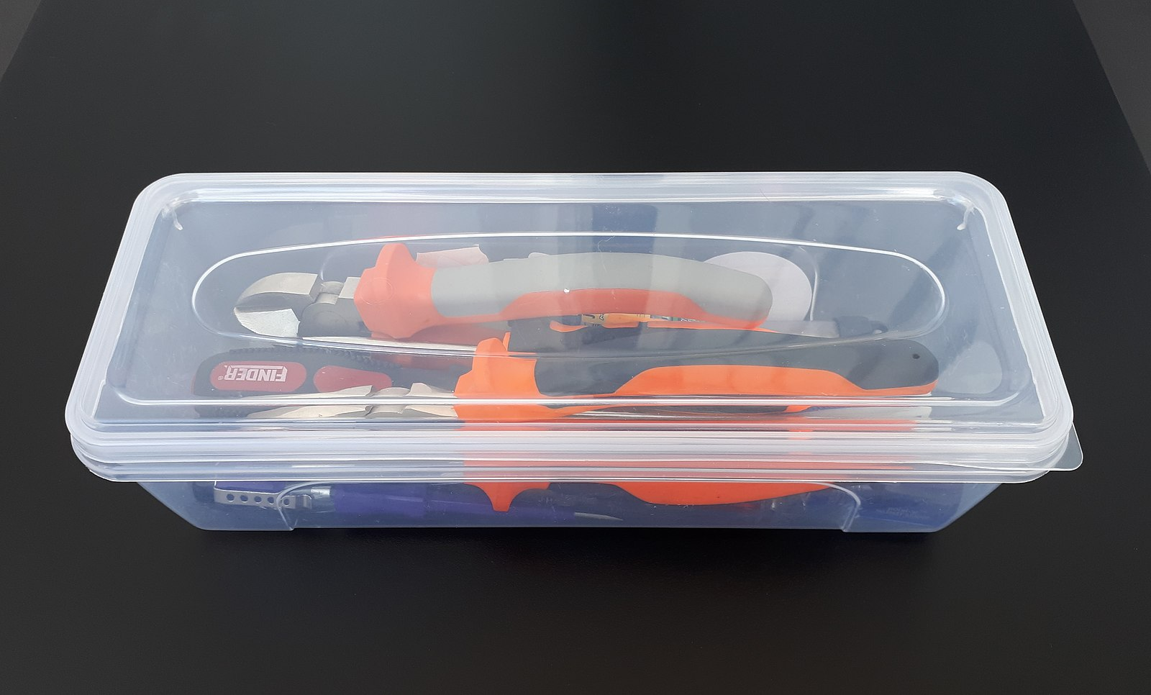
What is a container?
Dictionary definition:
something used to transport something else, holds things
Photo: Fructibus [CC0], from Wikimedia Commons
Notes:
The dictionary describes a container as some that is used to hold or transport something else.

Slide 5
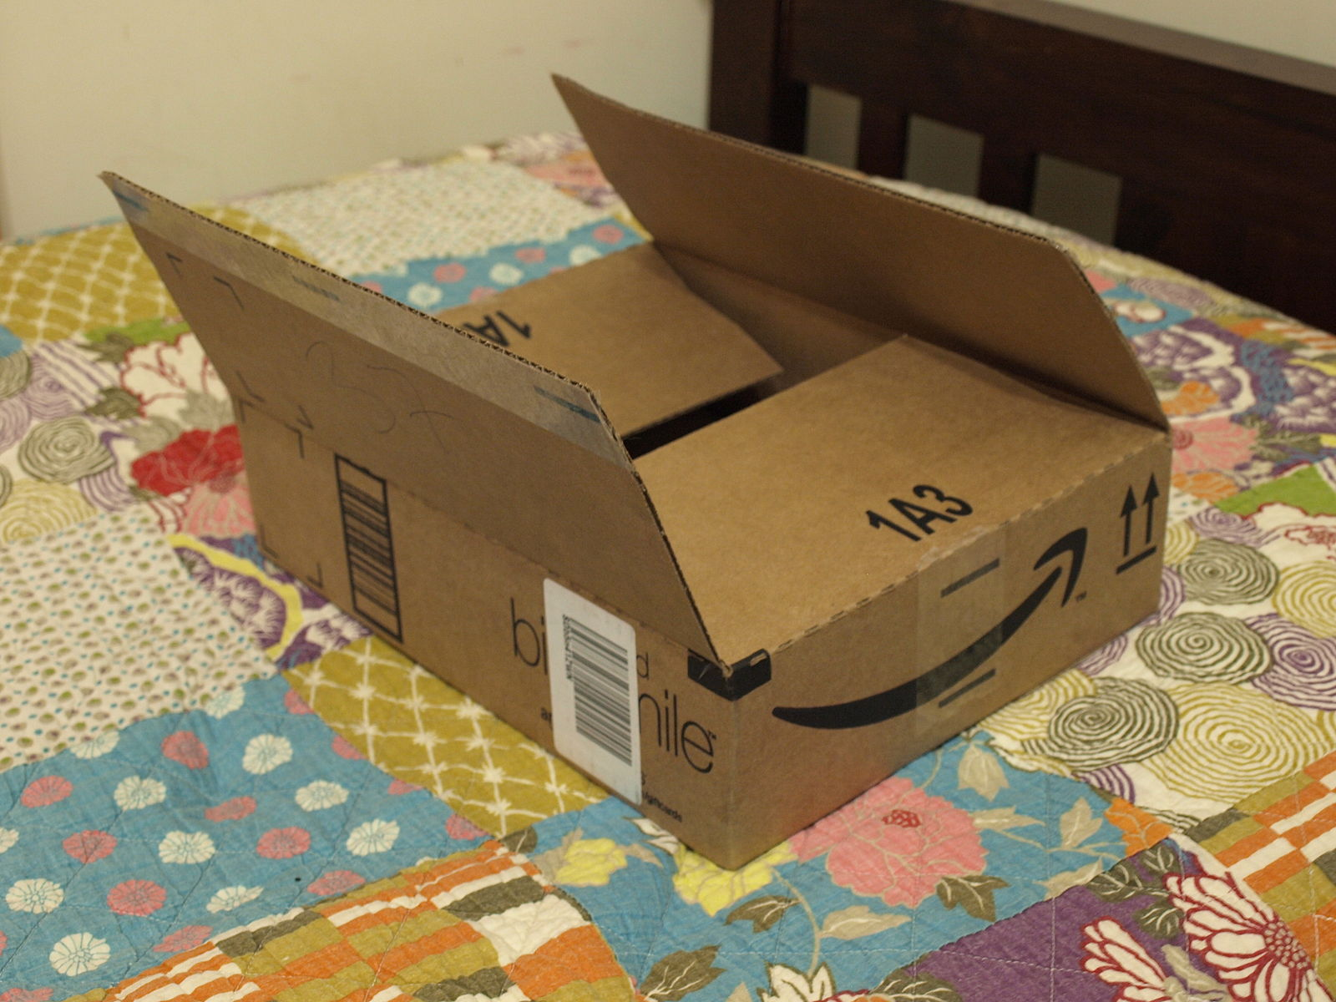
Software containers
In the software world containers are used to hold and transport applications.
Container
Application
Files
Libraries
Services
Photo: Matthew Paul Argall [CC BY-SA 3.0 (https://creativecommons.org/licenses/by-sa/3.0)], from Wikimedia Commons
Notes:
In the software world, containers are used to hold and transport applications.
Amazon physical containers are included free, Sorry on Amazon software containers will cost you $
The container can hold an application you wrote yourself – or something published by others.
It can and usually does hold other data and software needed by the application.
BUT take note of what you don’t see in that container…

Slide 6
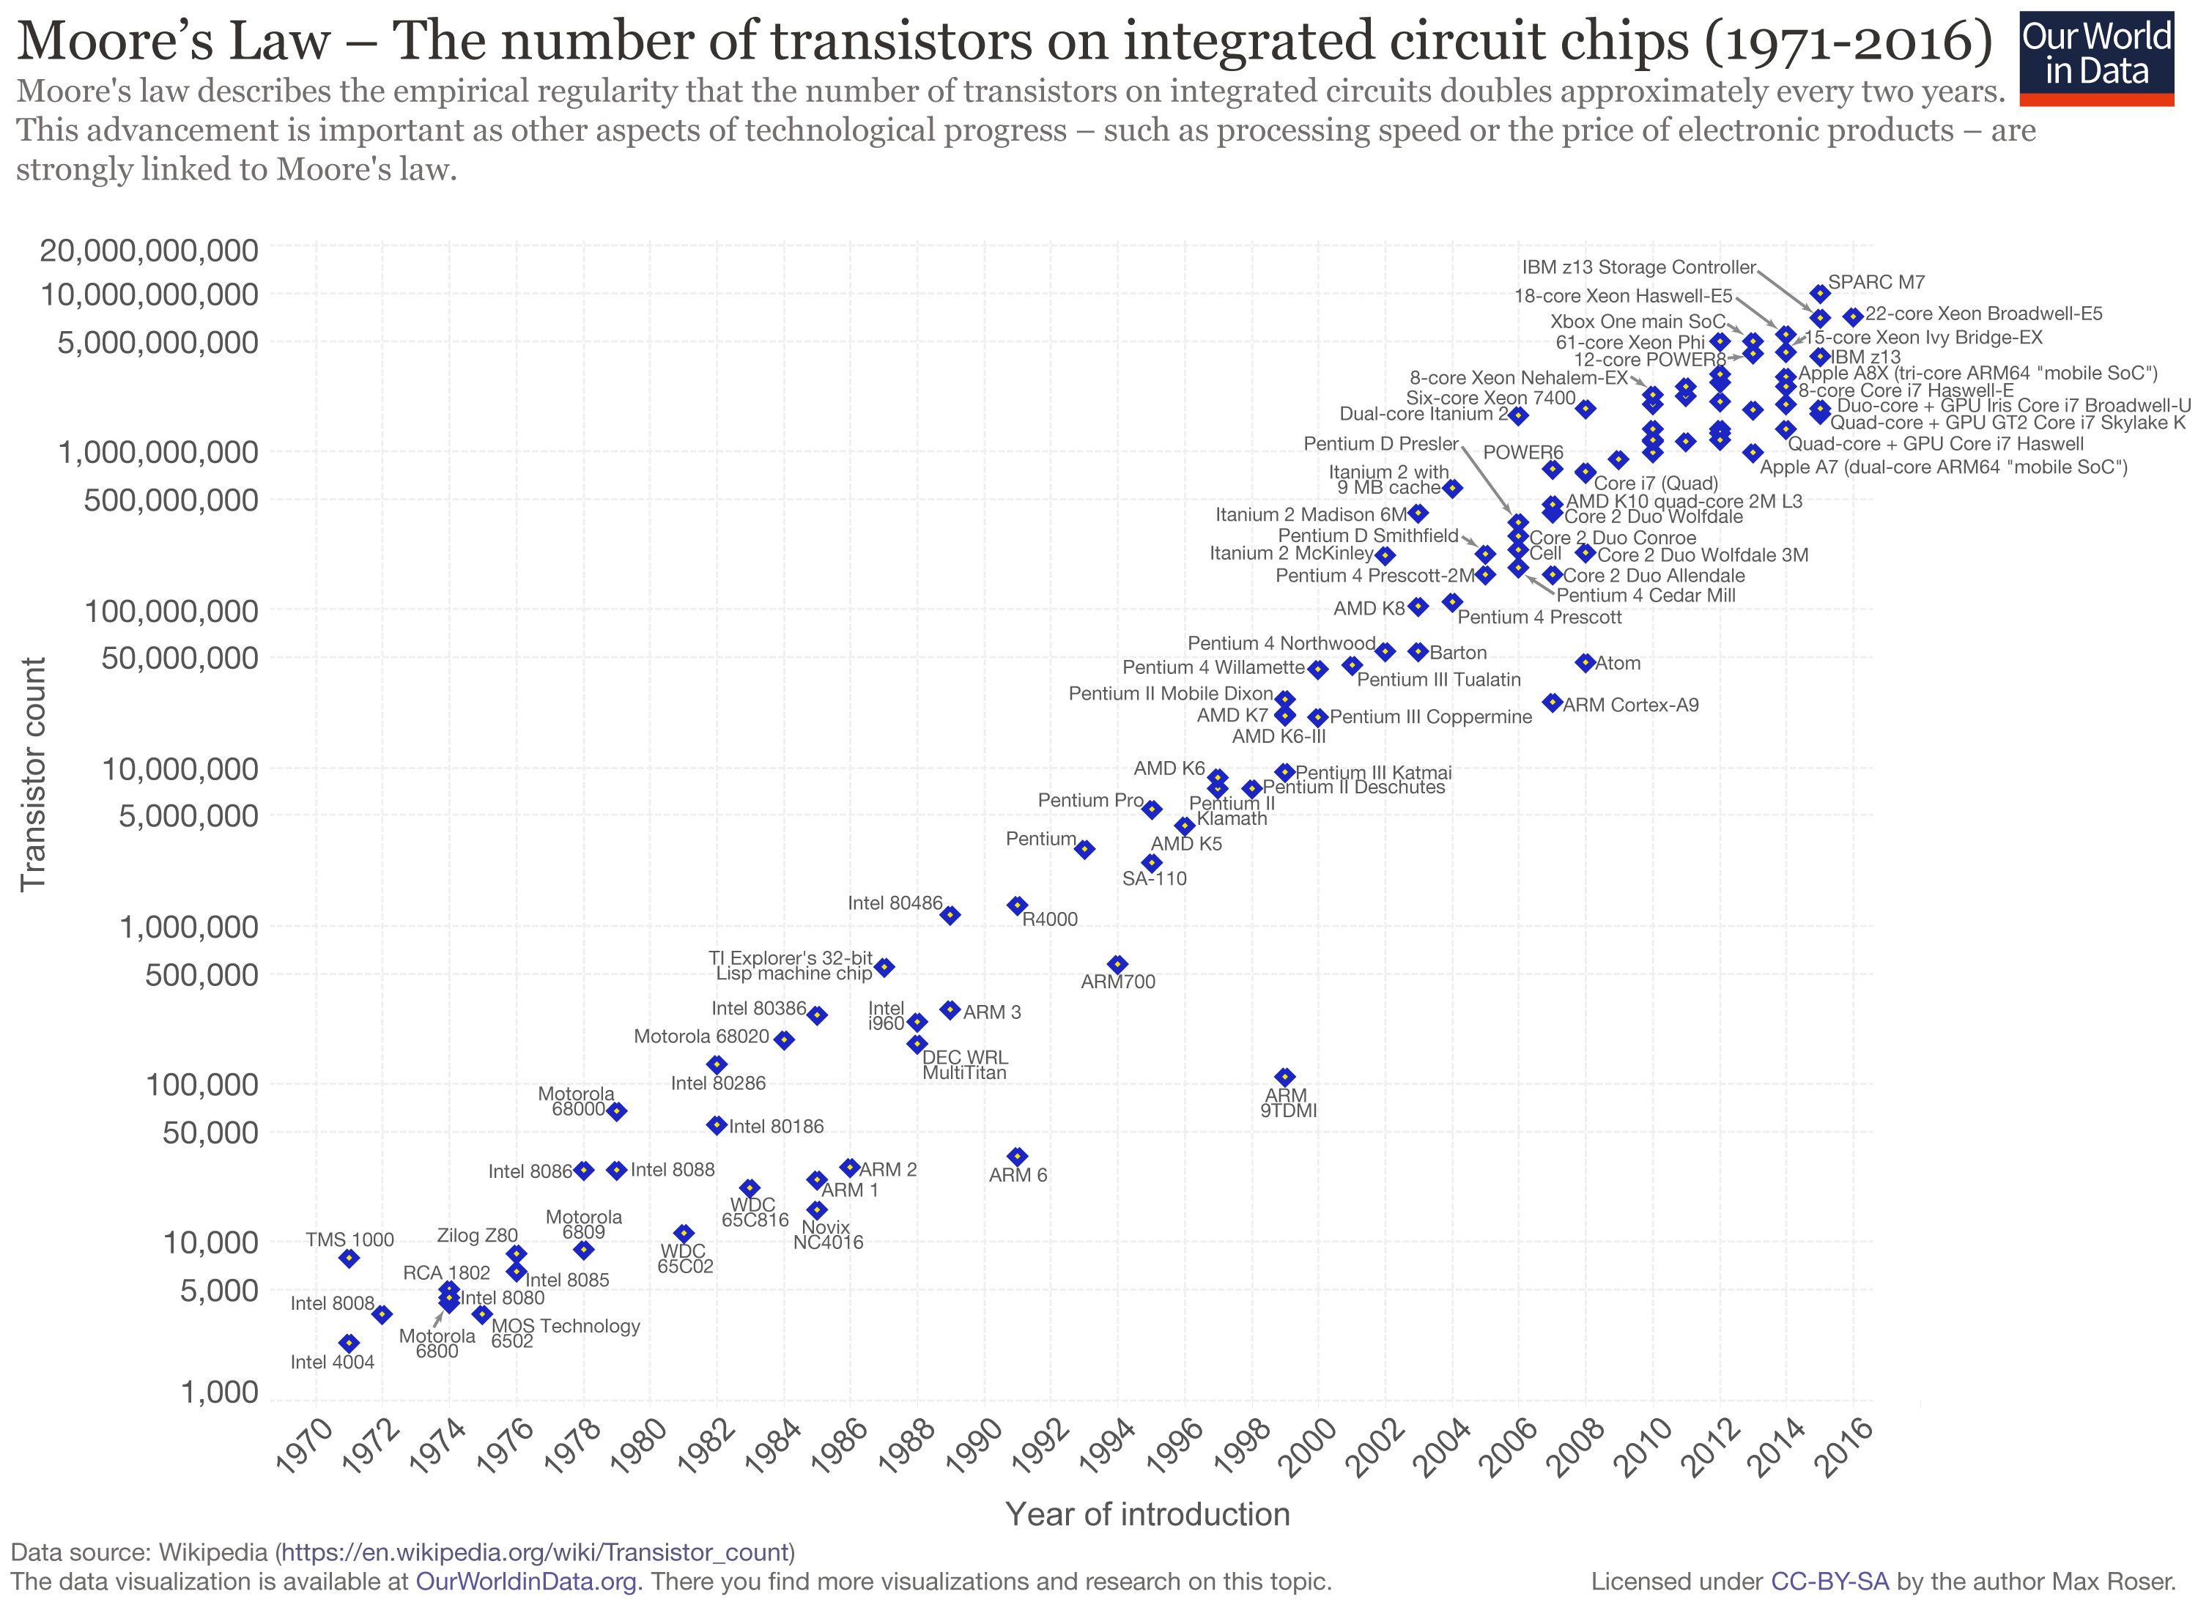
Moore’s Law
Observation: “the number of transistors on a chip doubles about every two years”
Often erroneously misstates as speed/capacity of computers doubles every 18 months
Used to be more true than it is now

Slide 7
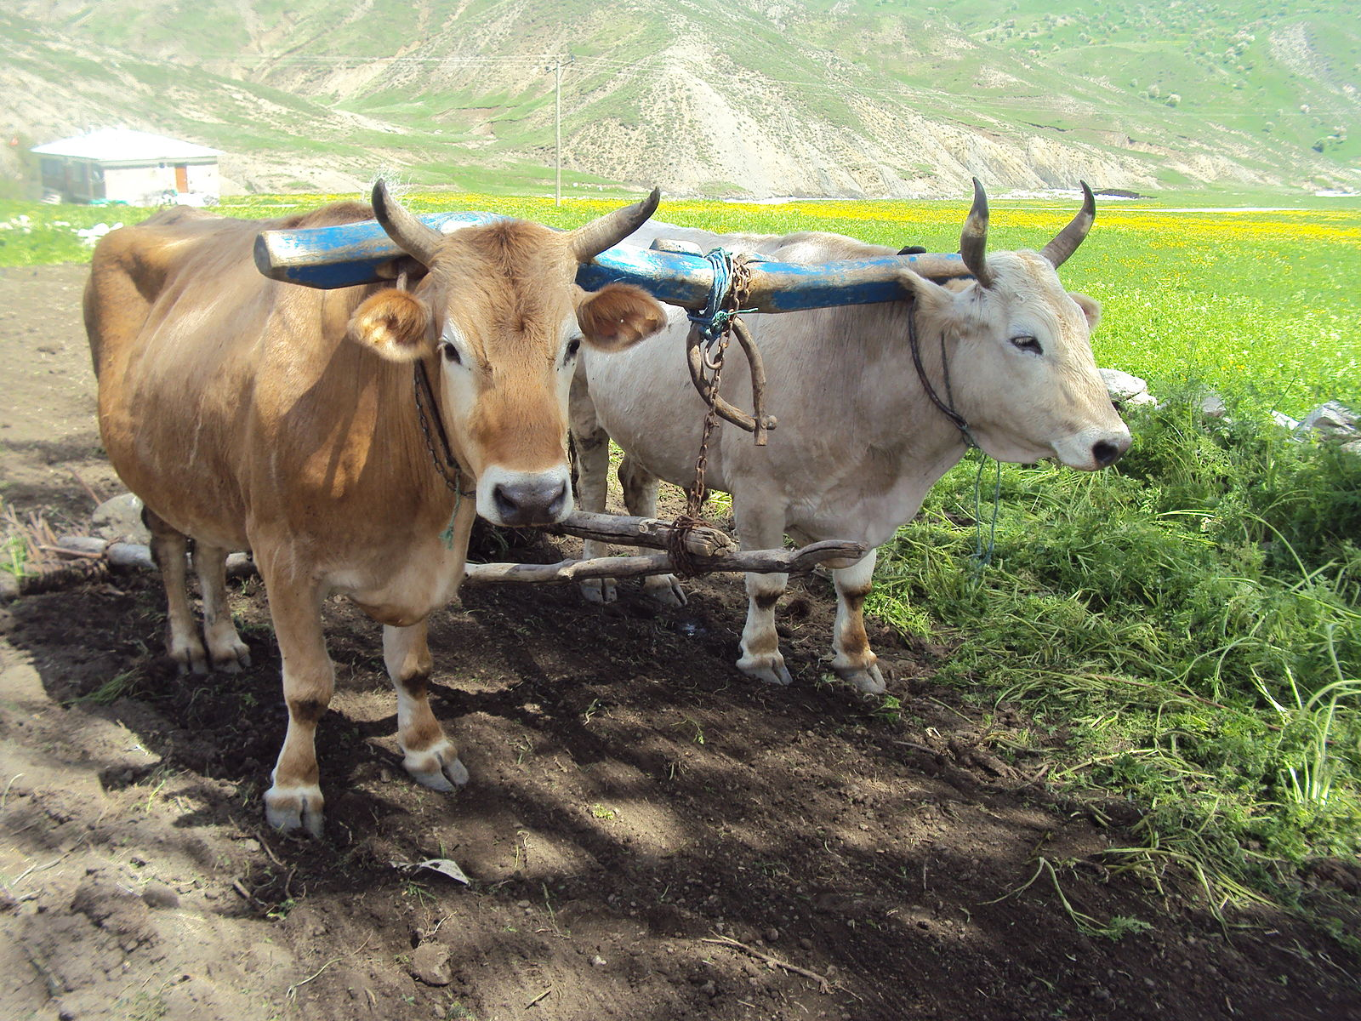
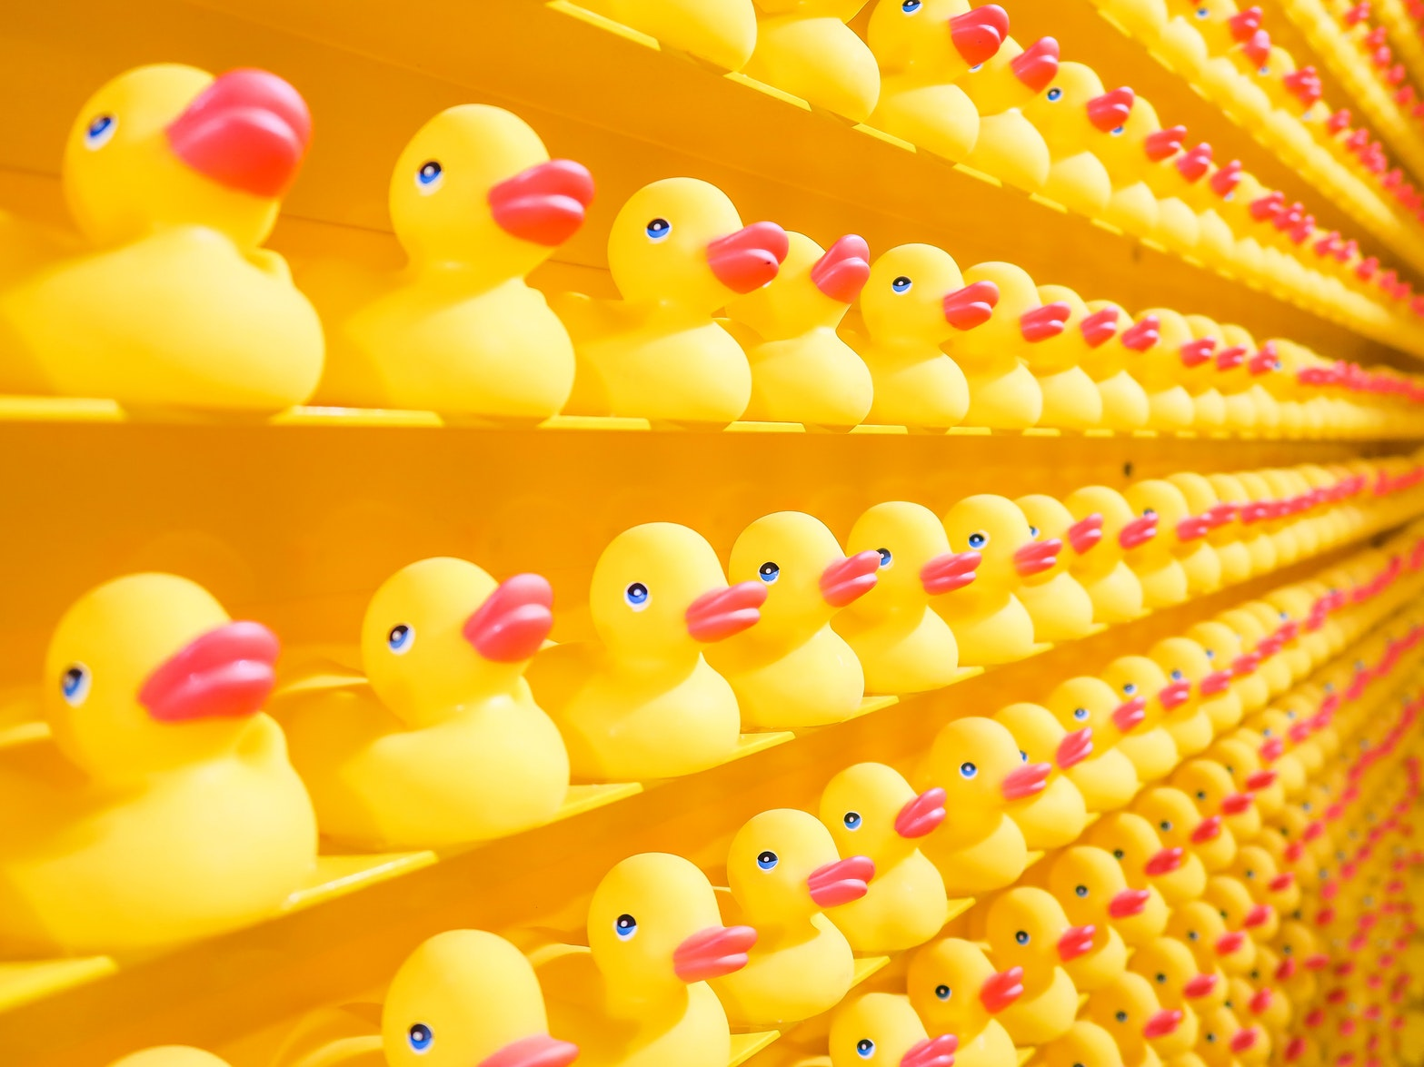
Seymour Cray
“Which would you rather use: two strong oxen or 1024 chickens?”
This quip was viewed as obvious into the 90s – but today you want the chickens
Photo Bibliophile [CC BY-SA 3.0 (https://creativecommons.org/licenses/by-sa/3.0)]
Photo Joshua Coleman on Unsplash
Notes:
https://www.youtube.com/watch?v=Tc_JWE_ypEk

Slide 8
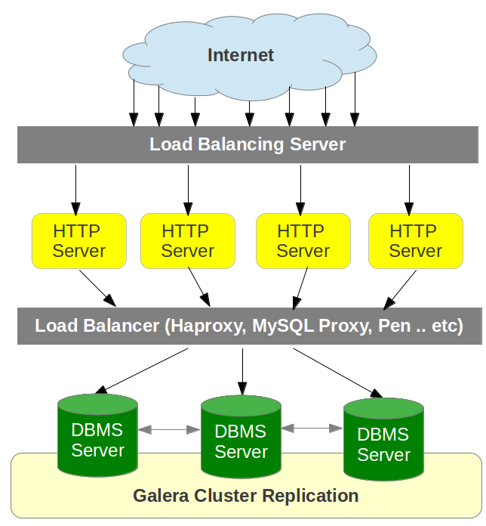
What is a load balancer?
Consumer interacts with load balancer as if it is a single entity (service)
The load balancer off loads requests to a variable sized pool of server apps
The size of the the pool of server apps can change while the load balancer remains running
Elements of the server pool can be replaced (updated)
Photo by Bo-Yi Wu CC 2.0 on flickr
Notes:
Load balancers can increase scale and improve availability – you can do the equivalent of changing out an engine while the plane is in the air

Slide 9
Options
deploy apps on machines
App #1
App #2
App #3
App #1
App #2
App #3
App #1
App #2
App #3
App #1
App #2
App #3
App #1
App #2
App #3
Bins/Libs
Bins/Libs
Bins/Libs
Bins/Libs
Bins/Libs
Bins/Libs
Bins/Libs
Bins/Libs
Bins/Libs
Bins/Libs
Bins/Libs
Bins/Libs
Bins/Libs
Bins/Libs
Bins/Libs
OS
OS
OS
OS
OS
OS
Docker Engine
Docker Engine
Docker Engine
Server
Server
Server
Hypervisor
OS
OS
OS
“bare metal”
Server
Server
Hypervisor
Virtual Machines
(VMs)
containers on “bare metal”
Server
containers in VMs

Slide 10
Container advantages
Compared to running code directly on hardware or in virtual machines
Start up faster
Are portable (unless you build them stupidly) – run them in a cloud or on your own computer. Run them on different types of computers.
Code is easily shareable, re-usable, publicly published if you desire.
Are useful for microservice architectures (building some thing big with small modular replaceable building blocks)
Are useful for building very large services that can deploy parallel instances of execution to meet demand peaks
Less work for you. Huge numbers of pre-packaged useful open source components are already published. For many popular open source projects, the container packaged form is the most tested and fully supported way to use it.

Slide 11

Containers
are they really revolutionary?
Sometimes a great thing needs a second great thing?
Photo by Riccardo Annandale on Unsplash

Slide 12
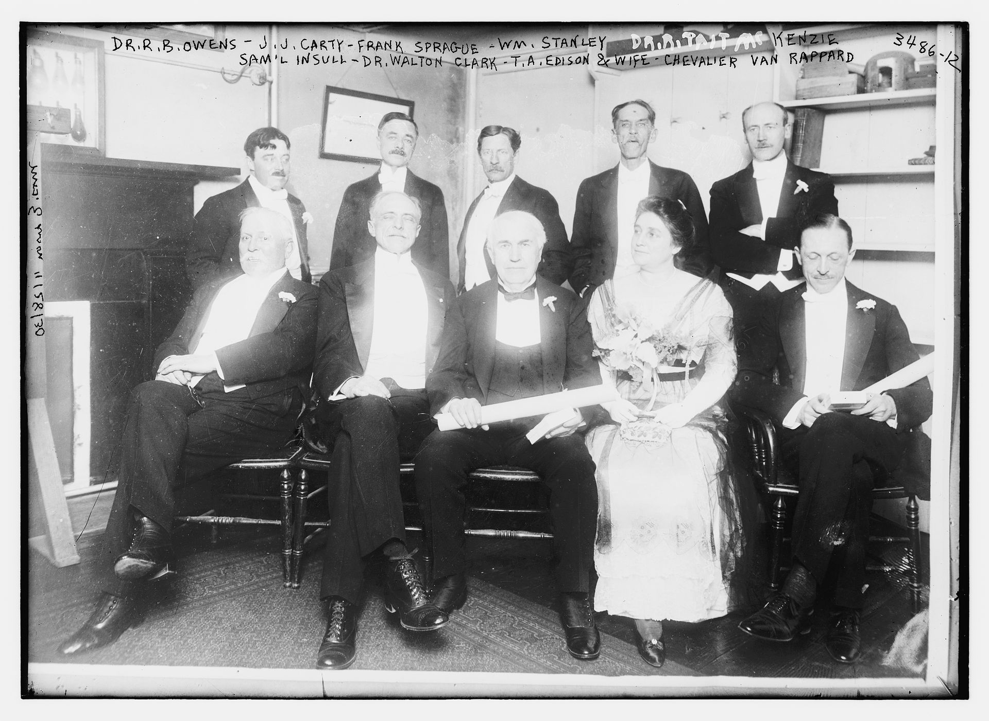
Thomas Edison
Franklin Institute Awards ceremony
Samuel Insull and the history of the electric utility
Photo Public Domain Library of Congress ggbain 19159

Slide 13
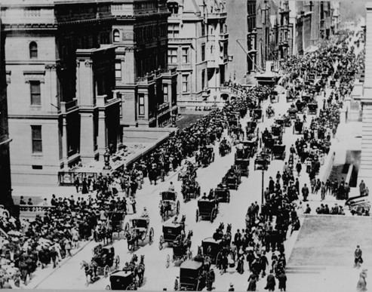
How fast can things change?
Can you spot the horse?
New York City - 1900
Photo US National archives

Slide 14
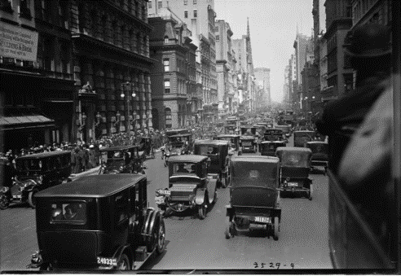
13 years later
Spot the horse
New York City - 1913
Photo by Charly W. Karl CC BY-ND 2.0 on flickr

Slide 15
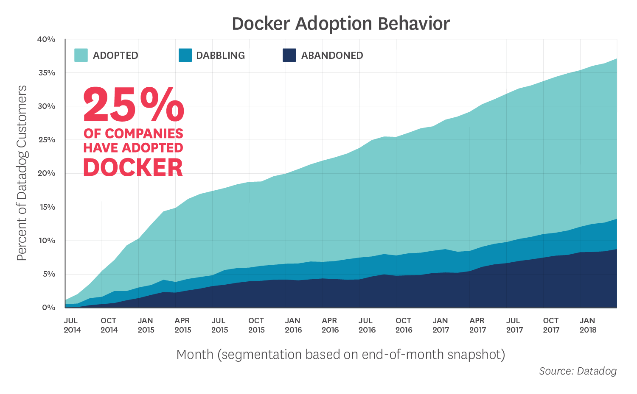
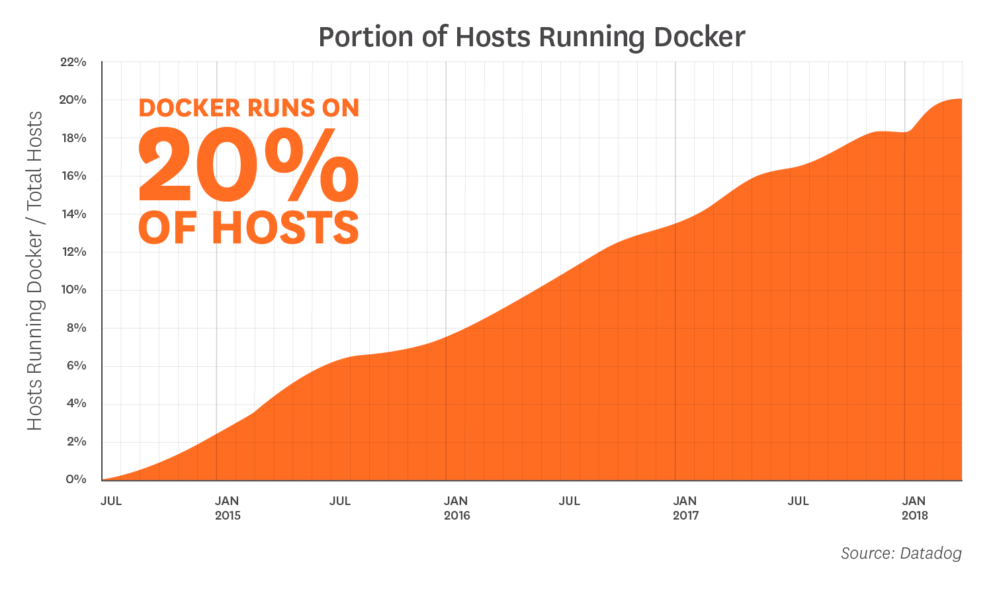
Containers use is growing rapidly

Slide 16
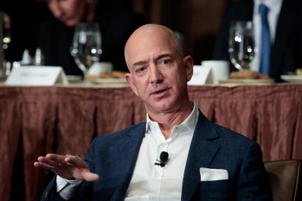
The nature of information demand is changing
Data generated is growing rapidly each year, and people want notifications and answers quicker
“Most decisions should probably be made with somewhere around 70% of the information you wish you had. If you wait for 90%, in most cases, you’re probably being slow.” Jeff Bezos
Photo by Riccardo Annandale on Unsplash
Notes:
Why containers and cloud are happening

Slide 17
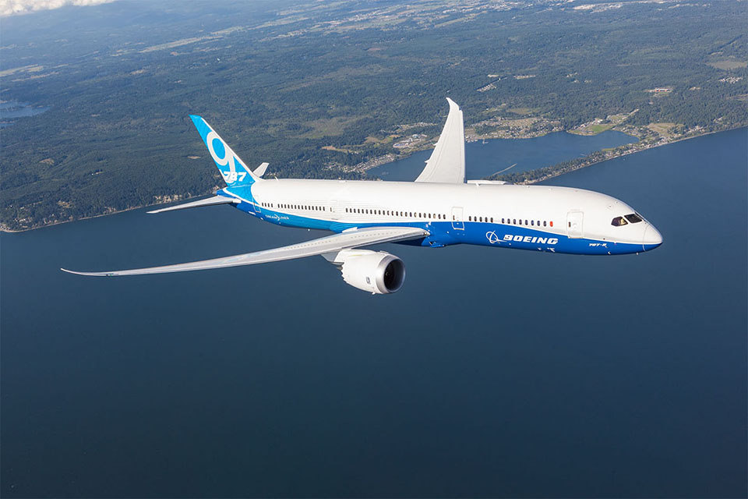
Boeing 787
Dreamliner
Imagine having this in the 1800’s?
Photo by Charly W. Karl CC BY-ND 2.0 on flickr

Slide 18
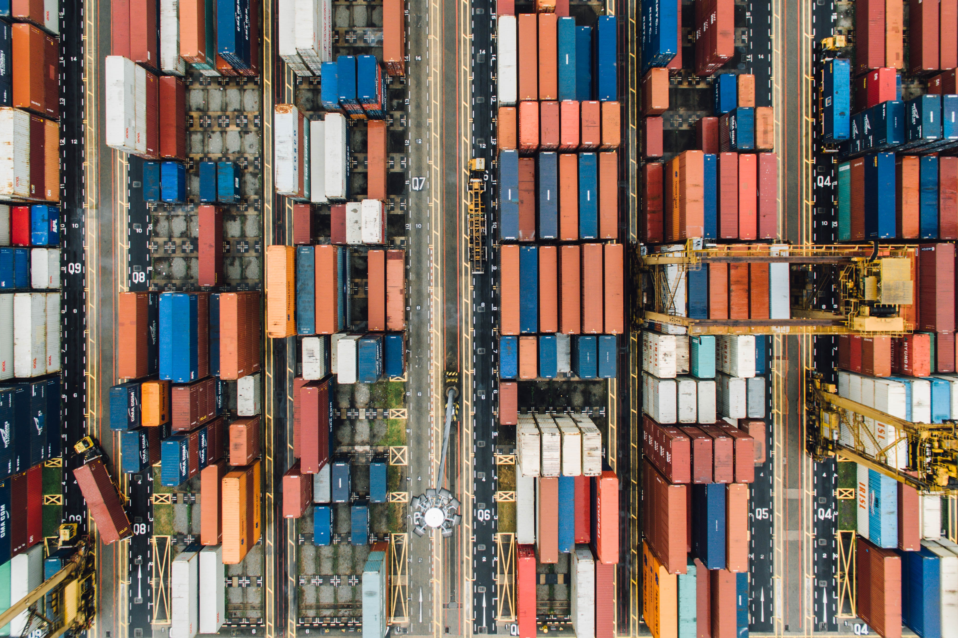
Containers
What if you need more than one, a lot more than one?
Photo by chuttersnap on Unsplash

Slide 19
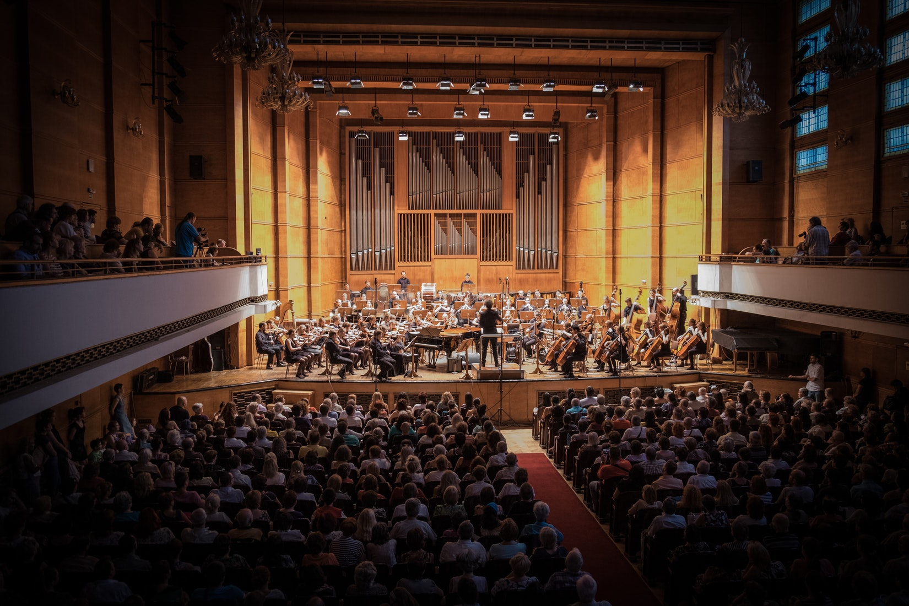
What do you need to deliver consistent service
Health Monitoring
Communications
Configuration
Enable Discovery
Security
Scaling
Scheduling
Photo by Manuel Nageli on Unsplash

Slide 20
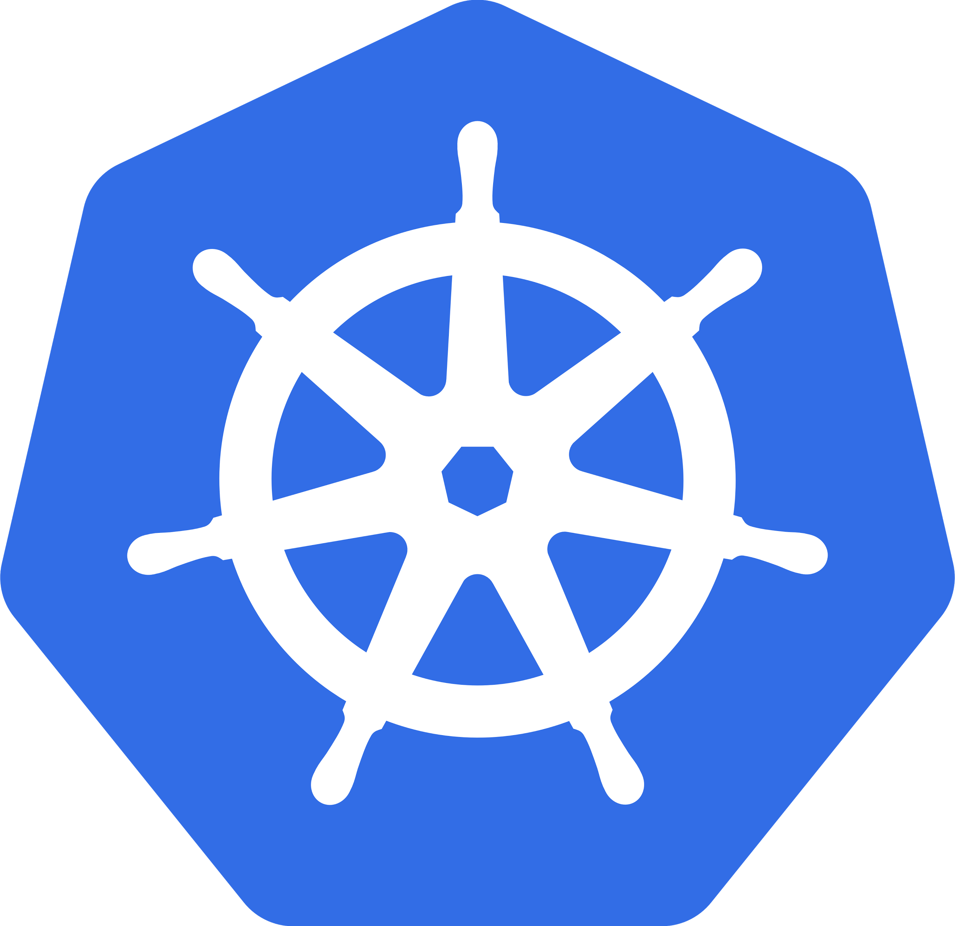
Kubernetes
Inspired by Google’s experience
Kubernetes (Greek for "helmsman" or "pilot")
Its development and design are heavily influenced by Google’s internal Borg system and many of the top contributors to the project previously worked on Borg.
The original name for Kubernetes within Google was project Seven of Nine, a reference to a Star Trek character that is a 'friendlier' Borg
Google's lawyers rejected taking the internal codename public, thus the Kubernetes name. The seven spokes on the wheel of the Kubernetes logo is an acknowledgment of the banished name.
Kubernetes v1.0 was released on July 21, 2015.

Slide 21
Kubernetes
Inspired by Google’s experience
Manage applications, not machines
Open source
Supports multiple cloud plus on premise datacenters
Inspired and informed by Google’s experiences and internal systems
Things that do what Kubernetes does are often called “container orchestrators”

Slide 22
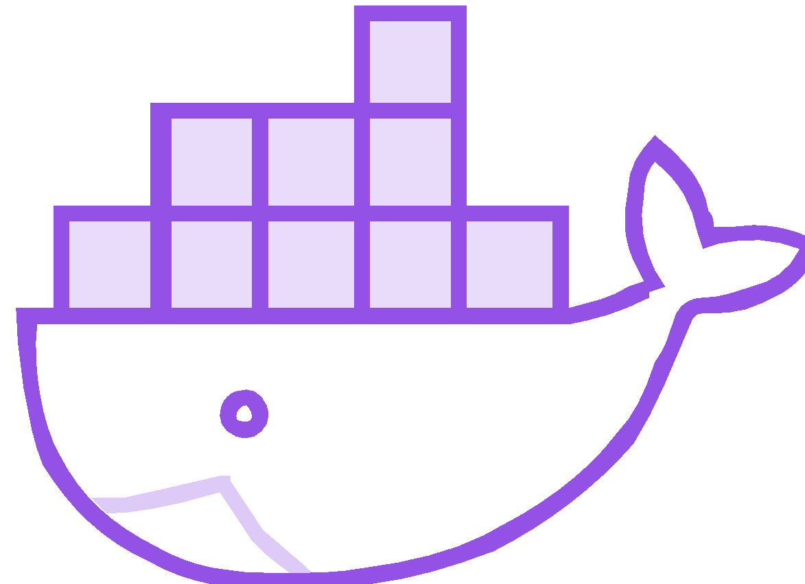
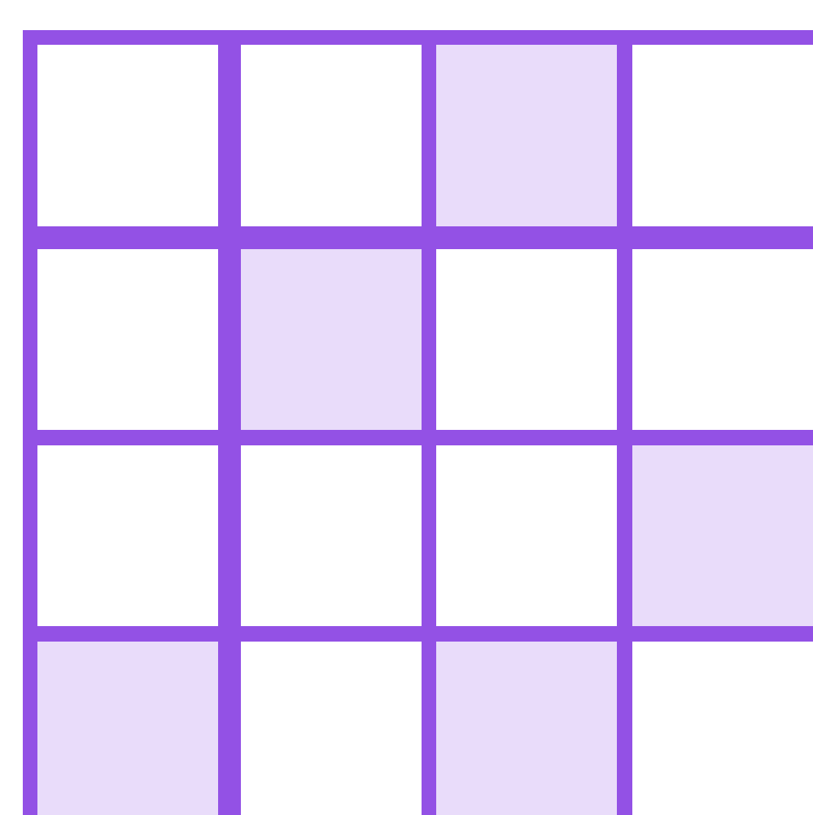
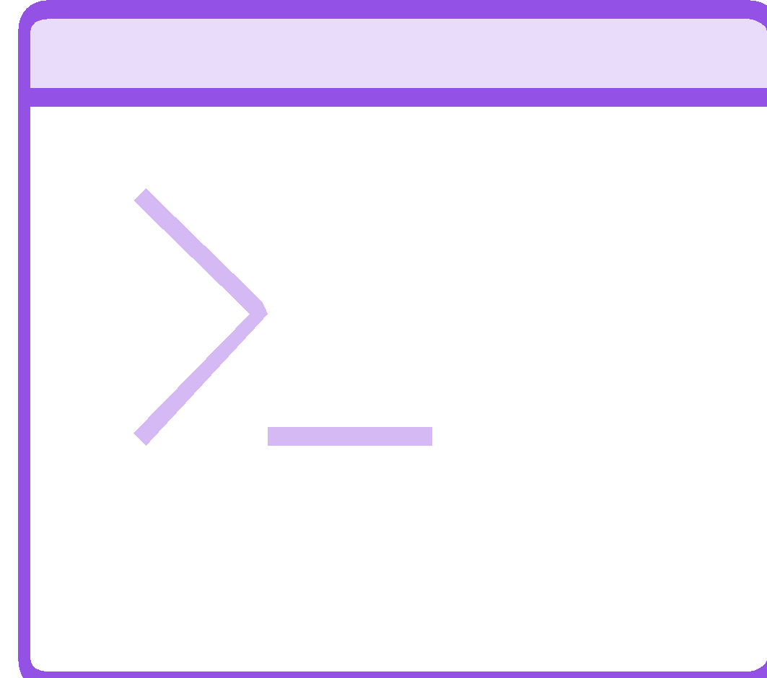
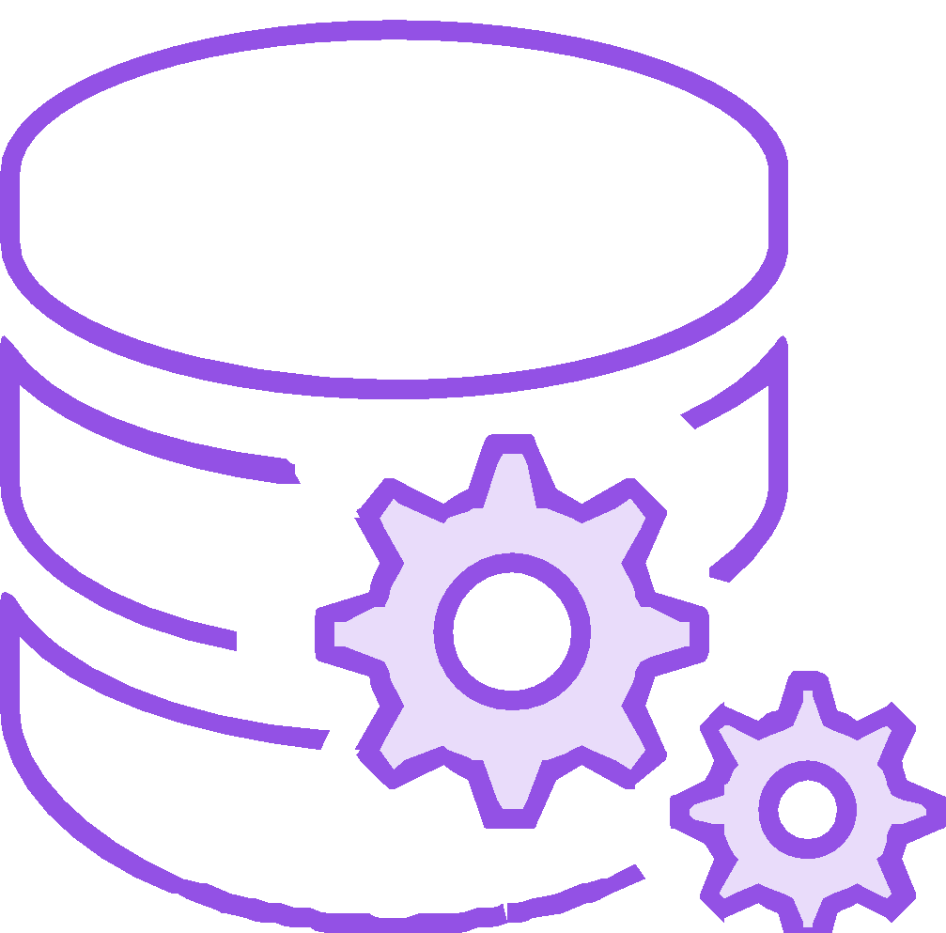
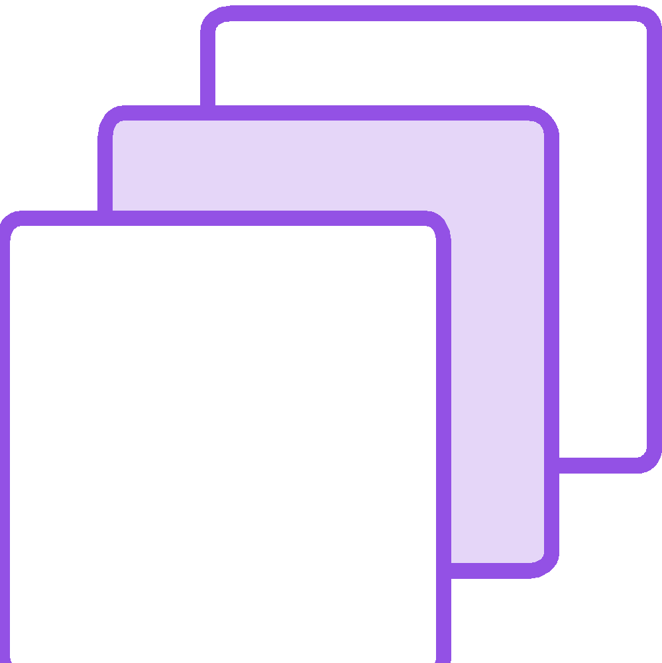
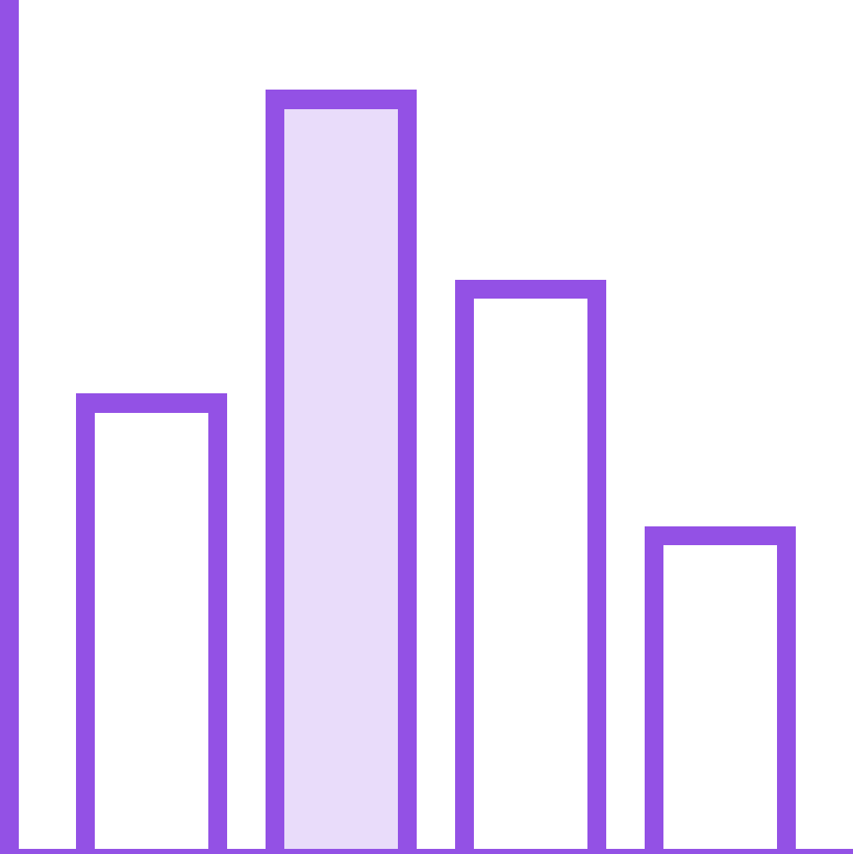
Why would you want to use a container orchestrator?
Docker, Microservices and container-based development, with CI/CD
Machine Learning, AI, Streaming Data Analytics, Fast Data, Big Data
Need self service IT user experience, without using Amazon, or using clouds supplemented with on-prem and edge capacity
Seek Google-like datacenter operations, off the shelf, instead of home-grown
Need app and service portability across public clouds + on-prem... with consistent staff skill set, and no cloud provider lock-ins
Automated and Integrated security, networking, storage management, logging, health monitoring

Slide 23
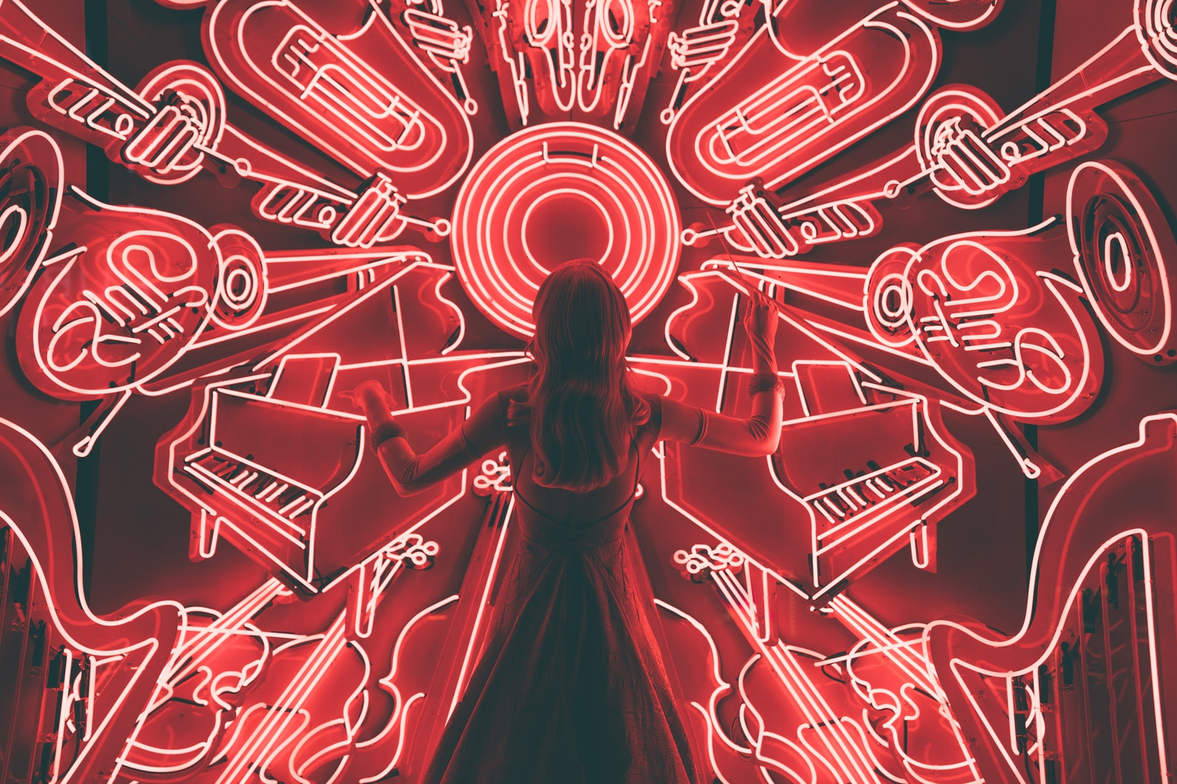
Called an orchestrator but more like Jazz Improv
Photo by Spencer Imbrock on Unsplash

Slide 24
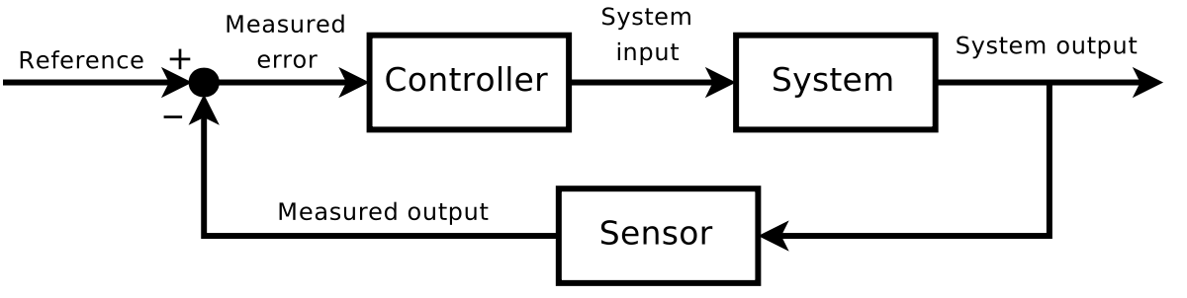
Kubernetes
Based on control loops
You tell Kubernetes the desired state
Kubernetes relentlessly:
measures current state
drives current state -> desired state
Recurring pattern of aspects in the system
measure
compare
act
Notes:
So what is a controller? It is a snippet of code that looks the declared desired state. It then looks at the state of the world. It then tries to reconcile these by making the state of the world look as it should according to the configuration.
If the controller fails or can't fully realize the desired state then it will be able to retry. If it takes time to make stuff happen the controller can be patient and diligently work.
This is a very stable distributed system pattern. Actions are idempotent and self-healing. If something goes wrong the controller will fix it. If the desired state changes while the controller is working it can change course and work toward the new desired state.

Slide 25

Desired state analogy
Say what you want – something else takes care of details
Child
Go upstairs
Get undressed
Put on pajamas
Brush your teeth
Pick out 2 stories
Employee
Go get some sleep

Slide 26
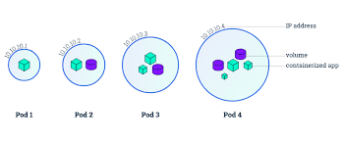
A Pod of whales containers
Scale out 3 tier application
The “atom” of Kubernetes. A group of containers – along with configuration
Kubernetes runs your application and services in pods, but much of Kubernetes itself is running as pods
Pods run on worker nodes – they never move once started – but they can be killed and restarted
Notes:
The most primitive thing in Kubernetes is a Pod. Practically this is a group of containers and the supporting configuration.

Slide 27
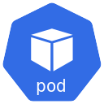

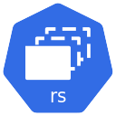
Deployments
Scale out multi-pod application or service
There should be:
3 front-ends (UI)
2 Services
1 Backend (database)
Notes:
The Deployment controller builds on top of the ReplicaSet. ReplicaSet is a way to say I want N pods running that are similarly configured.
A Deployment adds handling of rolling out changed configuration and versions. A better name might be "Rolling Update Deployment".

Slide 28
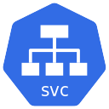
Services
Consume pod based service without a need to know details an abstraction that hides whether scale out is going on
Exposes a set of one or more pods for use by others as a unit – sometimes called a microservice

Slide 29


Ingress
Give services externally reachable URLs
User - consumers
Notes:
Note there is also a similar thing called a load balancer we won’t cover today

Slide 30
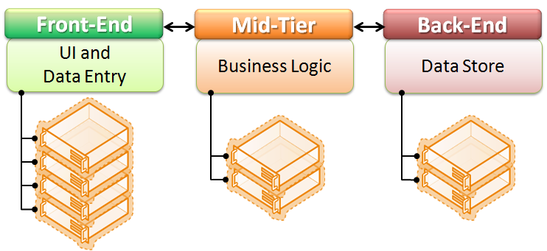
What is n-tier
In this example n = 3
Notes:
Workload can vary at each tier
Being able to scale capacity is valuable

Slide 31
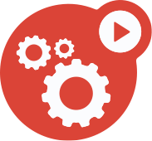
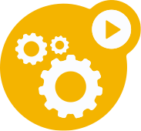
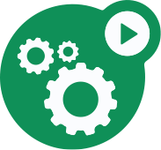
Desired state example
Scale out 3 tier application
There should be:
3 front-ends (UI)
2 Services
1 Backend (database)

Slide 32
Workshop time

Slide 33

Helm
Package manager for Kubernetes
Simplifies deployment and management of Kubernetes applications.
Notes:
Helm is sort of like an app store for Kubernetes. I works above the level of a container image or Pod.
It can manage Multi-Pod n-tier applications

Slide 34
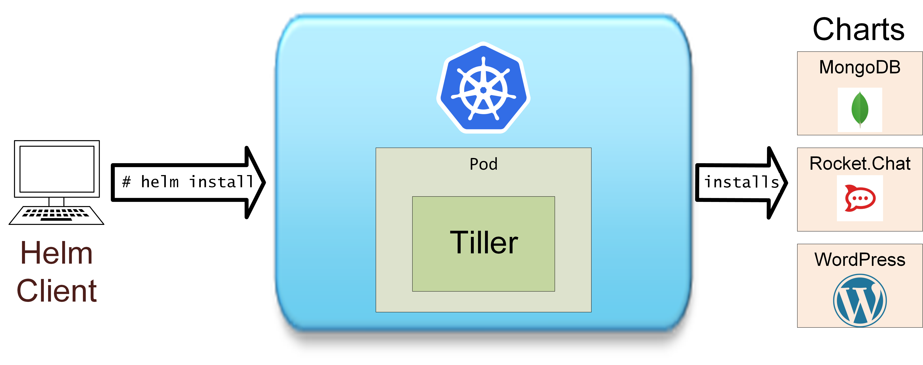
Helm Deployment: Components and steps
Notes:
Pre-reqs:
A Kubernetes cluster
Decide on and apply security configuration, if any (default=no authentication)
Install Helm and Tiller
Install helm for your platform (Windows, Linux, MAC @ https://github.com/helm/helm/releases)
# helm init
# helm version
# helm repo update
# helm install stable/mysql
WARNING: Helm install on a cluster using RBAC (like many PKS installations) will need an additional install step.

Slide 35
A typical Helm chart on github
rocketchat/
Chart.yaml # A YAML file containing information about the chart
requirements.yaml # OPTIONAL: A YAML file listing dependencies for the chart
values.yaml # The default configuration values for this chart
# Users can override a default during install
charts/ # A directory containing any charts upon which this chart
# will generate valid Kubernetes manifest files.
templates/NOTES.txt # OPTIONAL: A plain text file containing short usage notes
Notes:
Also optional are a LICENSE and README.md file.

Slide 36
Helm install
Value overrides can be provided in a yaml file:
$ helm install –f myvals.yaml wordpress
values.yaml:
imageRegistry: "quay.io/deis"
dockerTag: "latest"
pullPolicy: "Always"
storage: "s3"
myvals.yaml:
storage: “gcs"
EFFECTIVE RESULT
imageRegistry: "quay.io/deis"
dockerTag: "latest"
pullPolicy: "Always"
storage: “gcs"
+
=

Slide 37

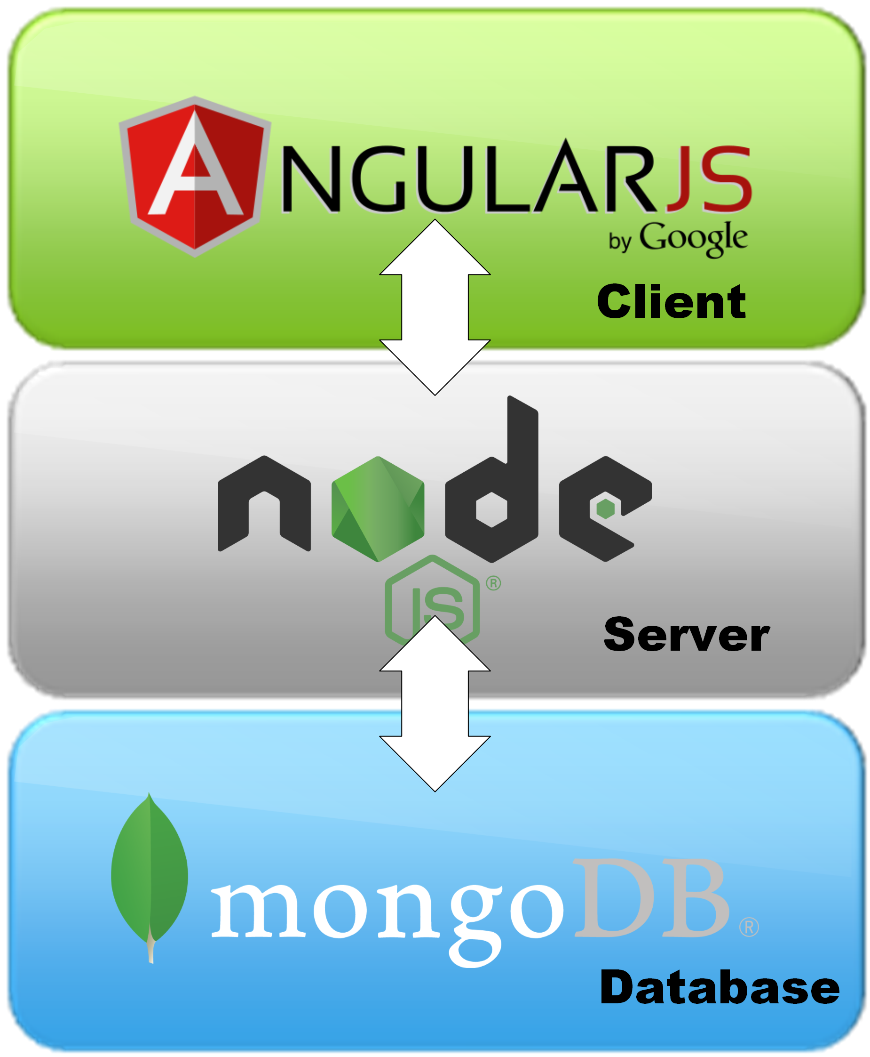
N-tier
RocketChat deployment using Kubernetes with Helm
RocketChat is an open source multi-user messaging system that has many of the features of Slack
It is built using the Node.js based Meteor web app framework. Meteor uses a MongoDB NoSQL database as its backend to hold state.

Slide 38
What you will do
myvals.yaml
mongodb:
persistence:
enabled: true
storageClass: standard
accessMode: ReadWriteOnce
size: 32Gi
persistence:
enabled: true
storageClass: xxx
accessMode: ReadWriteOnce
size: 32Gi
$ helm install –name chat1 –f myvals.yaml stable/rocketchat
Notes:
We can see that pods are running, and that storage has been provisioned
kubectl get pod
kubectl get pv
kubectl get pvc

Slide 39


Steve Wong
@cantbewong

